Slide 1
Chapter 1 : Java Introduction
Prepared By : - Rutu Shah

Slide 2
Agenda
Basic introduction of java.
Java installation and ide used.
Java Syntax.
Comments in java.
Variables.
Data Types.
Type Casting.
Operators.

Slide 3
History of Java
Java is a popular Programming language and a Platform, created in the year 1995 by Sun Microsystems.
James Gosling is known as the father of Java.
Before Java, its name was oak.
But Later in 1994 it was renamed to Java as Oak was already a registered company.
Presently it is owned by oracle and more then 3 billion devices run java.

Slide 4
What is Java?
Java is a Programming language and a Platform.
Java is a high level, robust, object-oriented and secure programming language.
It is used for:
Mobile applications (specially Android apps)
Desktop applications
Web applications
Web servers and application servers
Games
Database connection
Embedded System
Smart Card
Robotics and much more.

Slide 5
Why are we using Java?
Java works on different platforms (Windows, Mac, Linux, Raspberry Pi, etc.)
It is one of the most popular programming language in the world
It is easy to learn and simple to use
It is open-source and free
It is secure, fast and powerful
It has a huge community support (tens of millions of developers)
Java is an object oriented language which gives a clear structure to programs and allows code to be reused, lowering development costs
As Java is close to C++ and C#, it makes it easy for programmers to switch to Java or vice versa

Slide 6

Java Installation
Some PCs might have Java already installed.
To check if you have Java installed on a Windows PC, search in the start bar for Java or type the following in Command Prompt (cmd.exe):
If Java is installed, you will see something like this (depending on version):
If java is not installed you can download from oracle.com
Well, we can write code for java in notepad as well as integrated development environment(IDE) like eclipse, Intellij IDEA, netbeans which are particularly useful when managing larger collections of Java files.
We can see live demo for installing java.

Slide 7
Example of Java
Before moving forward towards example let us know that in java, every application begins with a class name, and that class name must match the filename.
Below is given example of basic java program.
Test.java
public class Test{
public static void main(String args[]){
System.out.println(“Helllo, Welcome !”)
}
}

Slide 8
Explanation of Code
Every Line of code that runs in Java must be inside a class.
Name of the class should always start with an uppercase first letter.
As java is case – sensitive : “Test” and test has different meaning.
The main method.
public static void main(String args[])
The main() method is required and you will see in every java program.
System.out.println(“Hello“); - > is used to print a line of text to the screen.
The curly braces {} marks the beginning and the end of a block of code.
Each code statement must end with a semicolon.

Slide 9
Comments in Java
Comments can be used to explain Java code, and to make it more readable. It can also be used to prevent execution when testing alternative code.
Comments in java are categorized into two types.
1. Single Line Comment.
Single-line comment starts with two forward slashes ( // ).
Any text between // is ignored by java till it reaches end of the line.
2. Multi-Line Comment
Multi-line comment start with /* and ends with */.
Any text between /* and */ will by ignored by java.
Example
//This is comment
/*The code below will print the words
Hello to the screen */
System.out.println(“Hello”);

Slide 10
Variables in java
Variables are containers for storing data values.
In Java, there are different types of variables, for example:
String - stores text, such as “Hello”. String values are surrounded by double quotes
int – stores integers(whole numbers), without decimals, such as 123 or -123.
float – stores floating point numbers, with decimals such as 19.99 or – 19.99
char – stores single characters, such as 'a' or 'B'. Char values are surrounded by single quotes.
boolean - stores values with two states: true or false

Slide 11
Example of Variable Declaration
Syntax:- type variable_name = value;
Where type is one of Java’s type such as int, String and variable name is a,b or any name, and equal sign is used to assign values to the variable.
Variable name and field are same just to confuse developers
Example
String name = “Rutu”;
int bday = 14;
double contactno = 9090909090

Slide 12
Datatypes in Java
Data types in java are divided into two groups:
Primitive DataTypes:- which includes byte,short,int,long,float,double,boolean and char.
Non Primitive Datatypes : - which includes Strings, Arrays and Classes

Slide 13
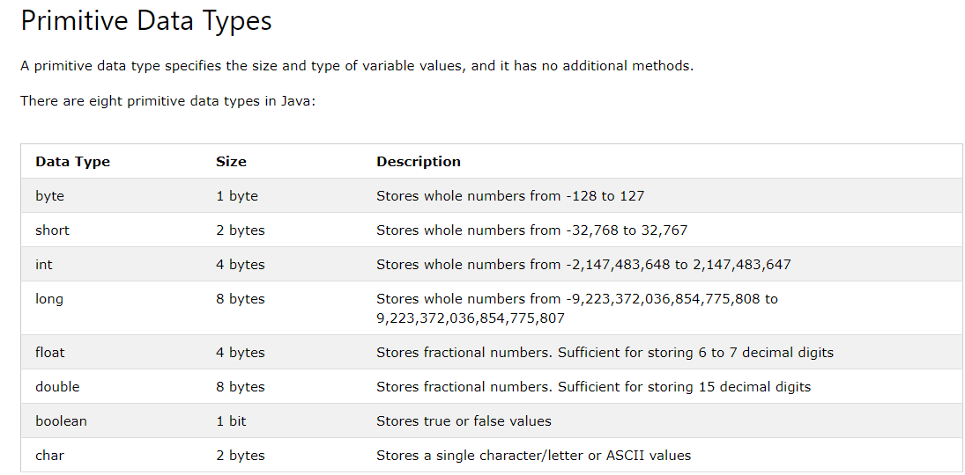

Slide 14
Type Casting in java
Type casting is when you assign a value of one primitive data type to another type.
In Java, there are two types of casting:
Widening Casting (automatically) - converting a smaller type to a larger type size
Narrowing Casting (manually) - converting a larger type to a smaller size type

Slide 15
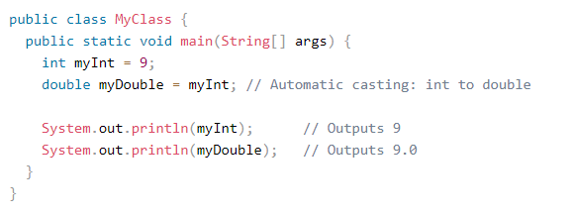
Widening Casting
Widening casting is done automatically when passing a smaller size type to a larger size type:
Example

Slide 16
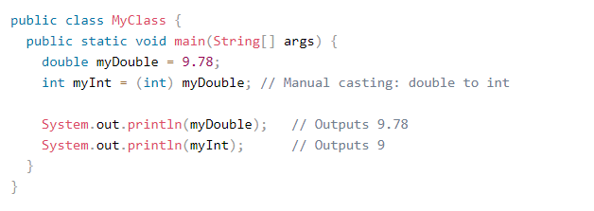
Narrowing Casting
Narrowing casting must be done manually by placing the type in parentheses in front of the value:
Example

Slide 17
Operators in Java
Operators are used to perform operations on variables and values.
Java divides the operators into the following groups.
Arithmetic operators
Assignment operators
Comparison operators
Logical operators
Bitwise operators

Slide 18
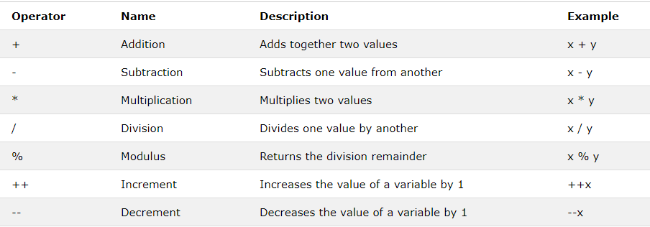
Arithmetic Operators
Arithmetic operators are used to perform common mathematical operations.

Slide 19
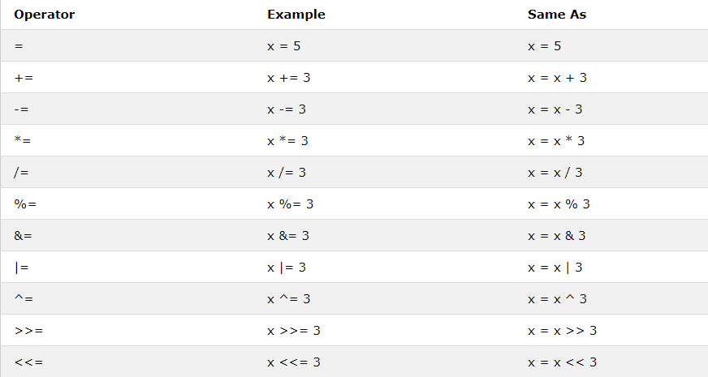
Java Assignment Operators
Assignment operators are used to assign values to variables.
In the example below, we use the assignment operator (=) to assign the value 10 to a variable called x.
Example:
int x = 10;

Slide 20
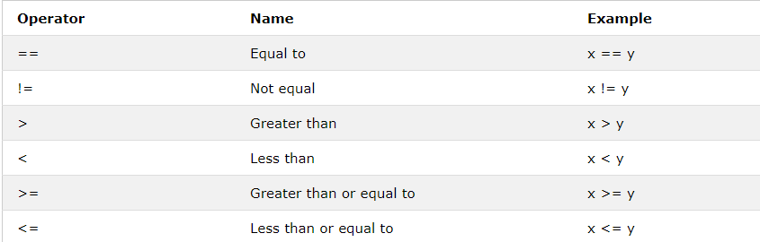
Java Comparison Operators
Comparison operators are used to compare two values:

Slide 21
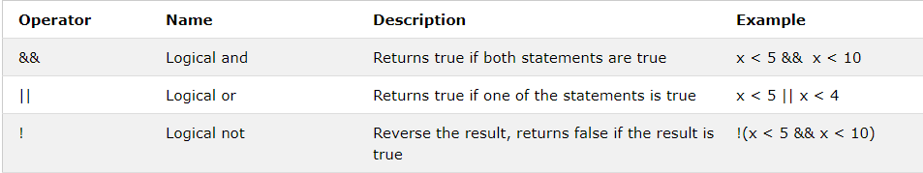
Java Logical Operators
Logical operators are used to determine the logic between variables or values:

